Slide 1
NTE 1010
Introduction to Finance for Engineers
Spring 2020
week
12
Foreign Exchange Markets

Slide 2
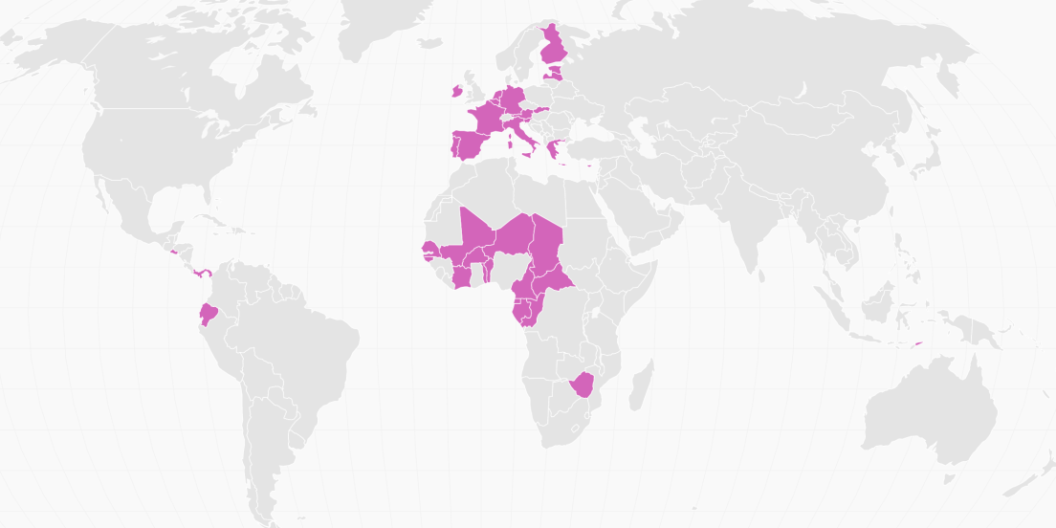
NTE 1010 – Introduction to Finance for Engineers
Foreign Exchange Markets
Exchange Rate
The price of one currency in terms of another is called the Exchange Rate.
Fluctuations in the exchange rate also affect both inflation and output,
and are an important concern to monetary policymakers.
Most countries of the world have their own currencies; a few do not.
€
East
Caribbean
$
US$
CFA
Franc
US$
US$
US$

Slide 3
NTE 1010 – Introduction to Finance for Engineers
Foreign Exchange Markets
Transactions
Spot transactions involve the immediate (two-day) exchange of bank deposits
at spot exchange rate.
Forward transactions involve the exchange of bank deposits
at some specified future date
at a predetermined forward exchange rate.
When a currency increases in value, it appreciates;
when it falls in value it depreciates (or it undergoes devaluation).
Exchange rates are important because
they affect the relative price of domestic and foreign goods.
When a country’s currency appreciates (rises in value relative to other currencies),
the country’s goods become more expensive abroad
and foreign goods in that country become cheaper
or vice versa.

Slide 4
NTE 1010 – Introduction to Finance for Engineers
Foreign Exchange Markets
FX Trade
FX market is organized as an over-the-counter market
in which several hundred dealers (mostly banks) stand ready to buy and sell deposits
denominated in foreign currencies.
Because these dealers are in constant telephone and computer contact,
the market is very competitive;
in effect, it functions no differently from a centralized market.
The volume in this market is colossal, exceeding 4 trillion $ per day.
Sizes of individual transactions are in excess of 1 million $.

Slide 5
NTE 1010 – Introduction to Finance for Engineers
Foreign Exchange Markets
How Do FX Rates Come Out ?
Law of One Price:
If two countries produce an identical good,
and transportation costs and trade barriers are very low,
the price of the good should be the same throughout the world
no matter which country produces it.
Suppose that American steel costs 100 $ per ton
and identical Japanese steel costs 10,000 ¥ per ton.
For the Law of One Price to hold,
1 $ should be worth 100 ¥.

Slide 6
NTE 1010 – Introduction to Finance for Engineers
Foreign Exchange Markets
How Do FX Rates Come Out ?
Theory of Purchasing Power Parity (PPP)
states that exchange rates between any two currencies
will adjust to reflect changes in the price levels of the two countries.
The theory of PPP is simply an application of the Law of One Price
to national price levels rather than to individual prices.
Suppose that the Yen price of Japanese steel rises 8% (to 10,800 ¥) due to inflation in Japan
while the Dollar price of the American steel rises 4% (to 104 $) due to inflation in the US;
then 1 $ should be worth 103.85 ¥ reflecting the inflation difference.

Slide 7
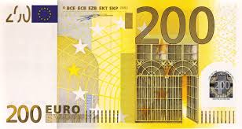
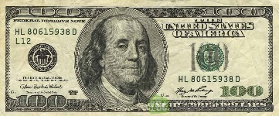
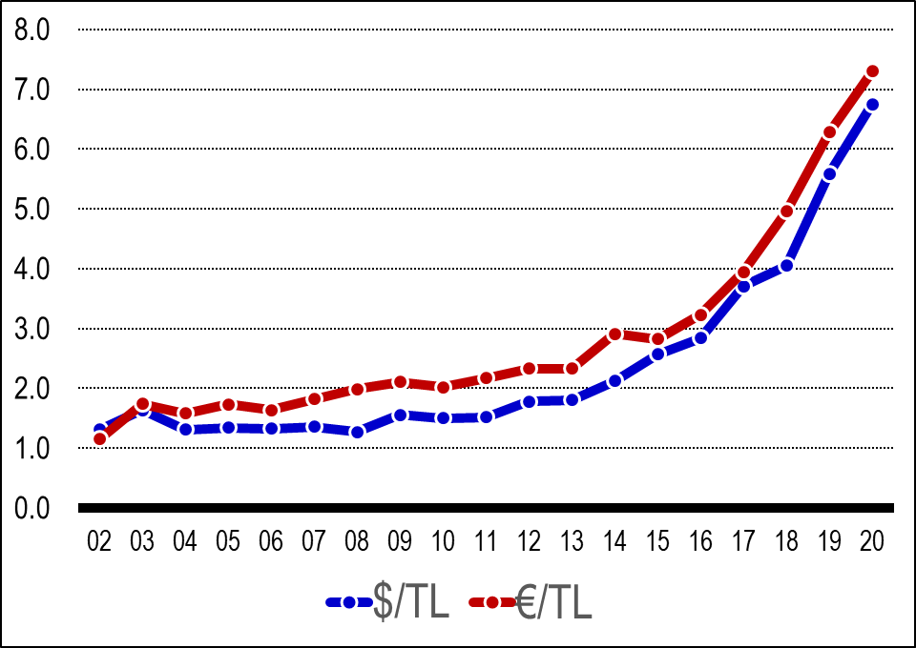
  NTE 1010 – Introduction to Finance for Engineers
  Foreign Exchange Markets
  $/TL and €/TL Exchange Rates
  $ and € are the two most basic currencies in World trade and the Turkish foreign trade.

Slide 8
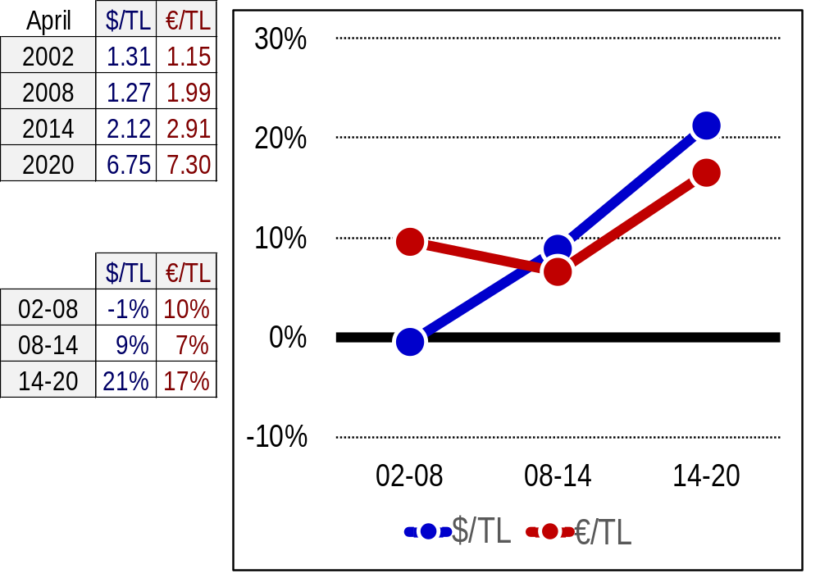
  NTE 1010 – Introduction to Finance for Engineers
  Foreign Exchange Markets
  Average Annual Devaluation of TL against $ and €

Slide 9
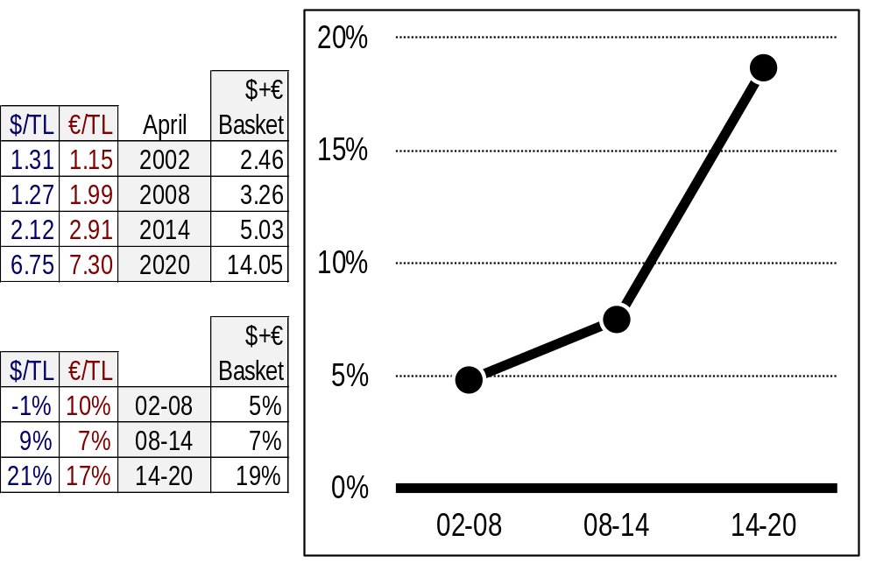
  NTE 1010 – Introduction to Finance for Engineers
  Foreign Exchange Markets
  Average Annual Devaluation of TL against FX Basket of $ and €

Slide 10
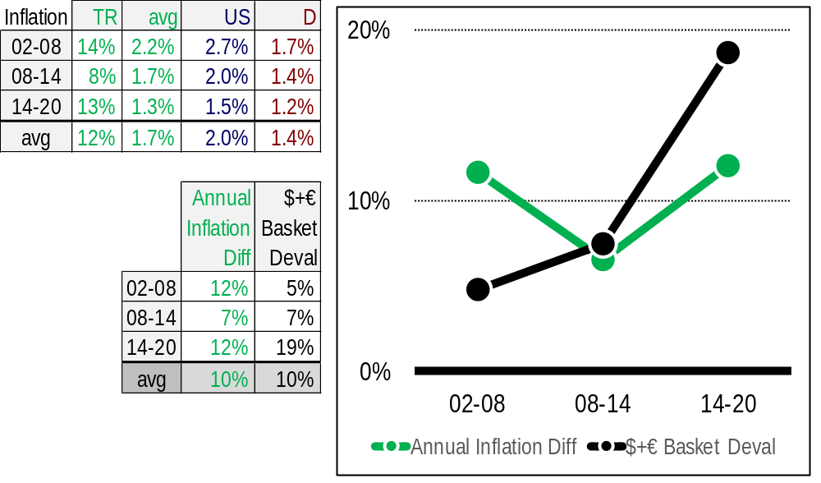
  NTE 1010 – Introduction to Finance for Engineers
  Foreign Exchange Markets
  Avg Ann Devaluation of TL against $+€ Basket vs Avg Ann Inflation Difference

Slide 11
NTE 1010 – Introduction to Finance for Engineers
Foreign Exchange Markets
Interrelationship between FX Rates and Interest Rates
When domestic real interest rates rise,
the domestic currency appreciates
as demand for the domestic currency goes up.
On the other hand,
when domestic interest rates rise
due to to an unexpected increase in inflation (which effectively reduces real interest rates),
the domestic currency depreciates.

Slide 12
NTE 1010 – Introduction to Finance for Engineers
Foreign Exchange Markets
Calculating Forward FX Rate
Assume 1€ is bought for 6.45 TL and sold for 6.55 TL in the market today
and you ask a bank to quote €/TL rate for 1m € for 3 months from now
when you want to sell your export revenue.
The way the bank calculates the forward FX rate is as follows:
Since you will be bringing in 1m € to the bank 3 months from now,
with € borrowing interest at 4% per annum
the bank
[1] borrows 1m € / (1+(4%/4)) = 990,099 € today,
[2] sells those € for 990,099 *6.45 = 6,386,139 TL,
TL deposit rate at 12% per annum
[3] with those TL, makes a 3-month TL deposit
to get 6,386,139 *(1+(12%/4)) = 6,577,723 TL at the end of 3 months,
[4] 3 months later, gives those TL to you in exchange for 1m €
so the €/TL rate at that date would be
6,577,723 TL / 1m € = 6.58
for the bank purchasing your 1m € export revenue,
[5] with those €, pays back € that it borrowed 3 months ago.

Slide 13
NTE 1010 – Introduction to Finance for Engineers
Foreign Exchange Markets
Calculating Forward Rate for Purchasing FX
Assume 1€ is bought for 6.45 TL and sold for 6.55 TL in the market today
and you ask a bank to quote €/TL rate for purchasing 1m € for 3 months from now
when you want to pay for your imports.
The way the bank calculates the forward FX rate is as follows:
Since you will be taking 1m € out of the bank 3 months from now,
with € deposit rate at 2% per annum
the bank
[1] deposits 1m € / (1+(2%/4)) = 995,025 € today,
[2] in order to purchase those €, borrows 995,025 *6.55 = 6,517,414 TL,
TL loan rate at 18% per annum
[3] to be able to pay back that loan after 3-months
the bank will need 6,517,414 *(1+(18%/4)) = 6,810,698 TL at the end of 3 months,
[4] 3 months later, gives the 1m € deposit to you in exchange for 6,810,698 TL
so the €/TL rate at that date would be
6,810,698 TL / 1m € = 6.81
for the bank selling 1m € to you for your import payment,
[5] with those TL, pays back the TL loan that it took out 3 months ago.

Slide 14
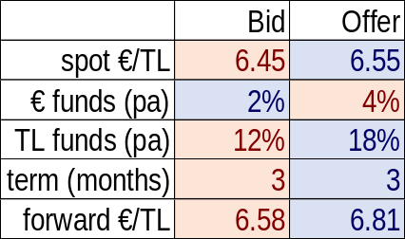
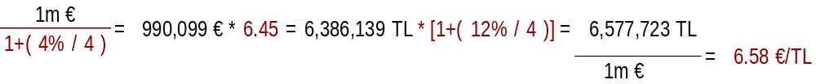
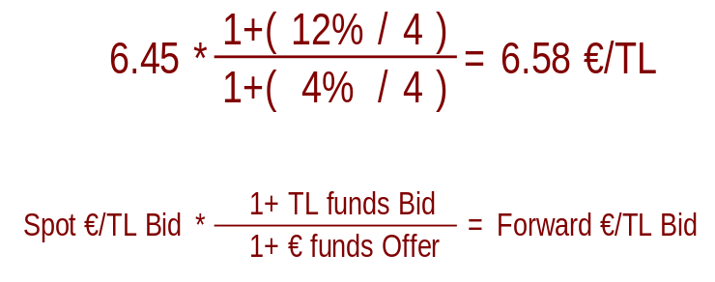
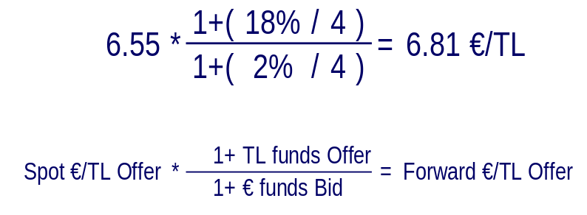
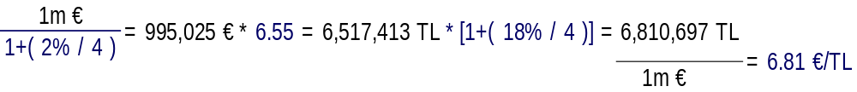
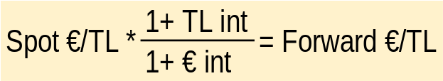
NTE 1010 – Introduction to Finance for Engineers
Foreign Exchange Markets
Calculating Forward FX Rate
Zero transaction costs are assumed.

